Slide 1

Sorting Georgia out
Understanding the precincts in a battleground state
Leland S. Crawford

Slide 2
Understanding the election
Finding the data
Presenting the data
Complication with the plan

Slide 3
The Plan
Finding the data
Battle Ground States
Georgia

Slide 4
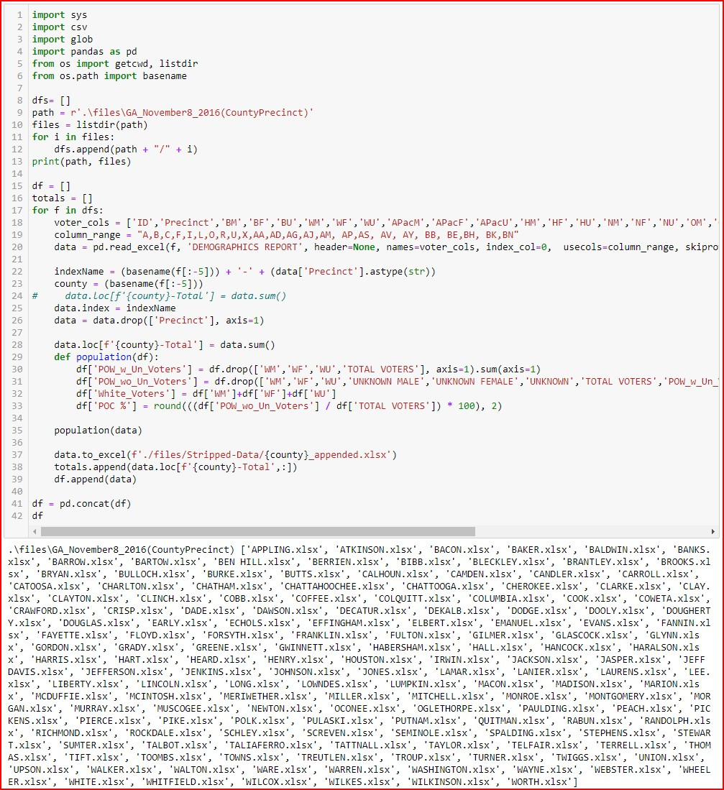
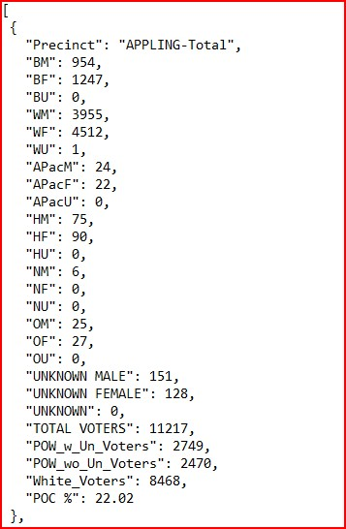
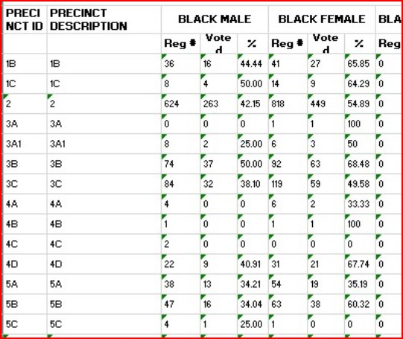
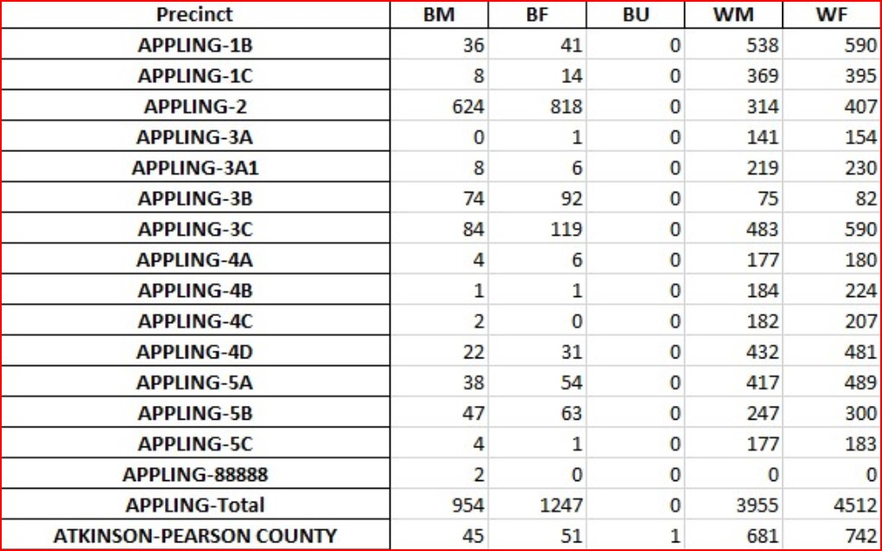
The Data Flow
Processing
in
Pandas
Single County
All of the Counties and Precintcts
JSON for a Single County Total

Slide 5

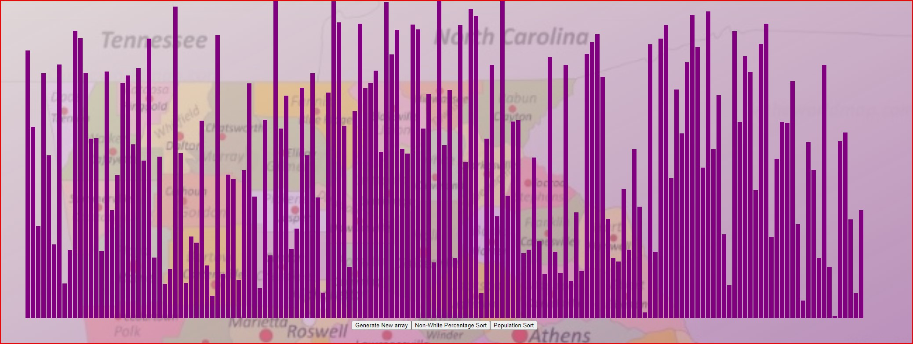
The Visualization

